Slide 1
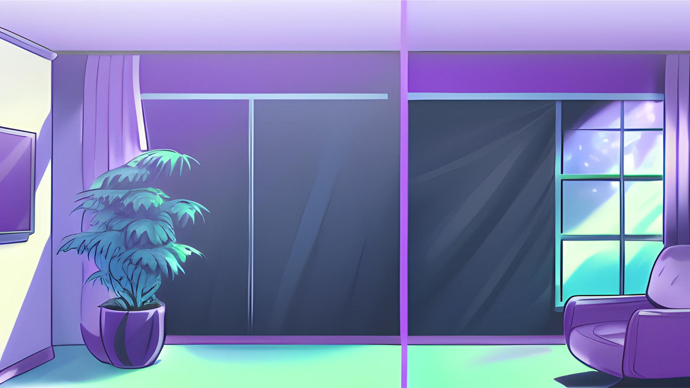
LEITMOTIFS: VIDEO GAMES, MOVIES, AND MORE!
Presented by Jillian Farley

Slide 2
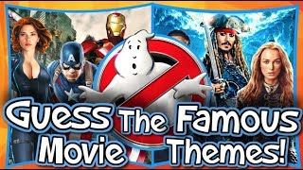
Activity

Slide 3
Activity
Let’s get to know each other!
Name:
Grade:
School:
Favorite Game/Movie/Show/etc.:

Slide 4
Goals
Learn the history and definition of leitmotifs
Describe the different purposes of leitmotifs
Analyze and interpret different leitmotifs in-depth

Slide 5
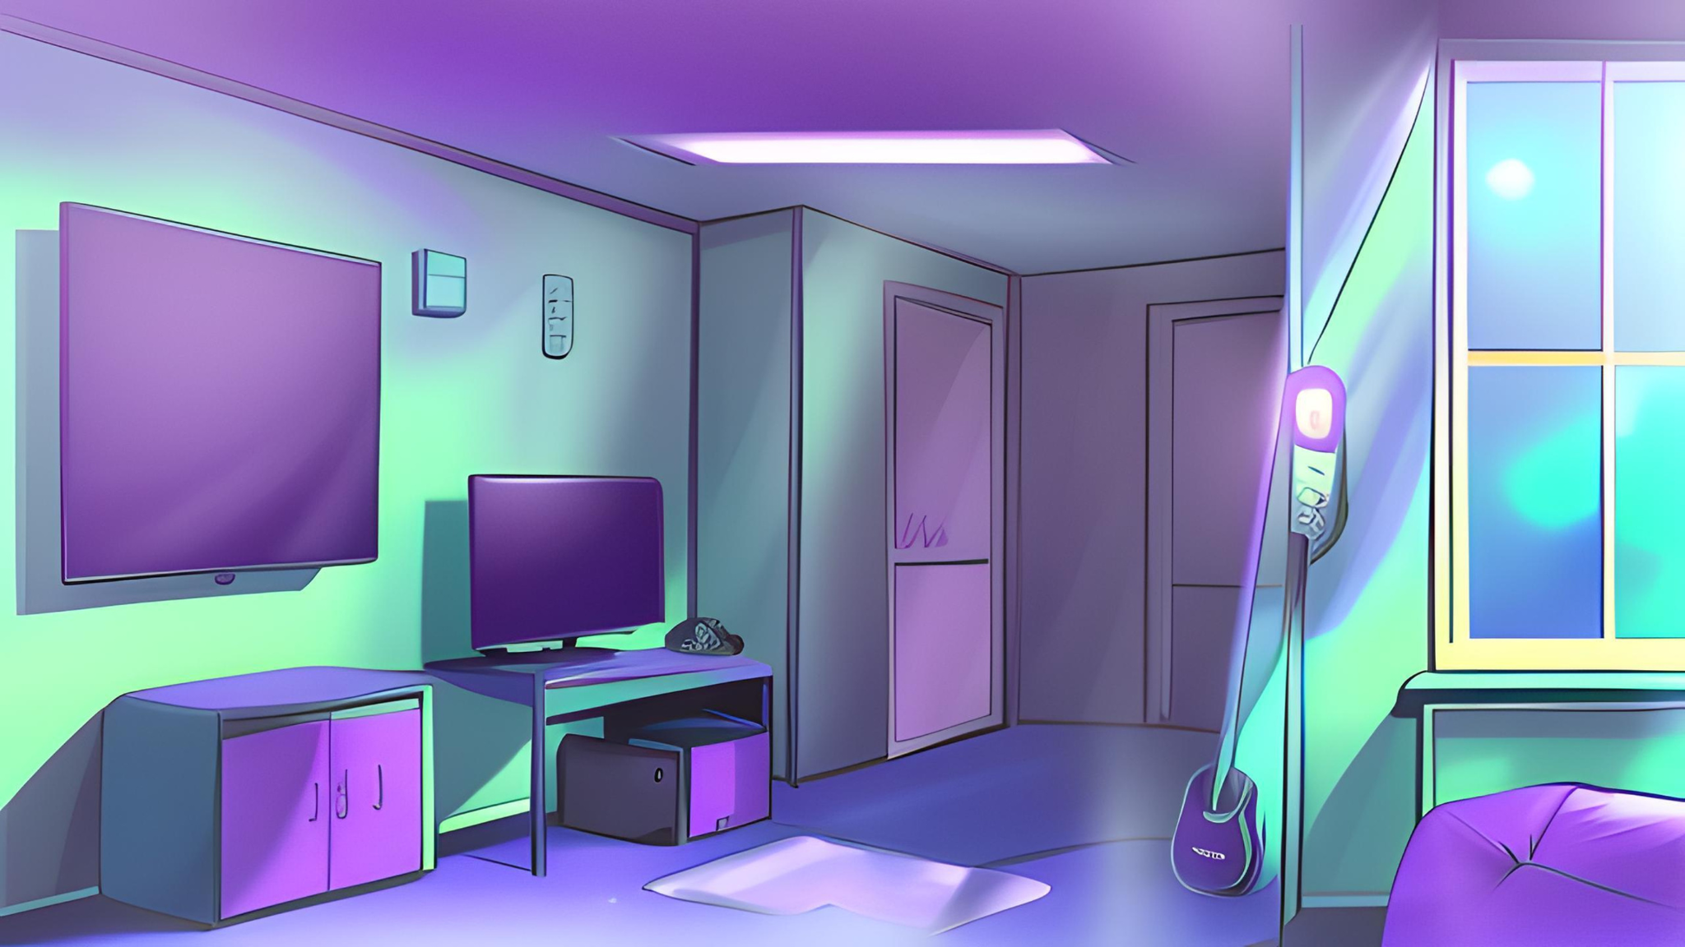
History of leitmotifs
Coined by Richard Wagner
Used 60+ leitmotifs in his opera Der Rings des Nibelungen

Slide 6
Definition of leitmotif
Leitmotiv (leading motif)
Recurring, recognizable, evolves with dramatic context

Slide 7
Theme vs. leitmotif
Shorter sequence of notes
Associated with something specific
Recurring, memorable audio in context of character, place, theme/concept/idea

Slide 8
How to change a leitmotif
Instrument
Pace
Tone
Key
Major/Minor

Slide 9
EXAMPLES:
Person, place, theme/idea

Slide 10
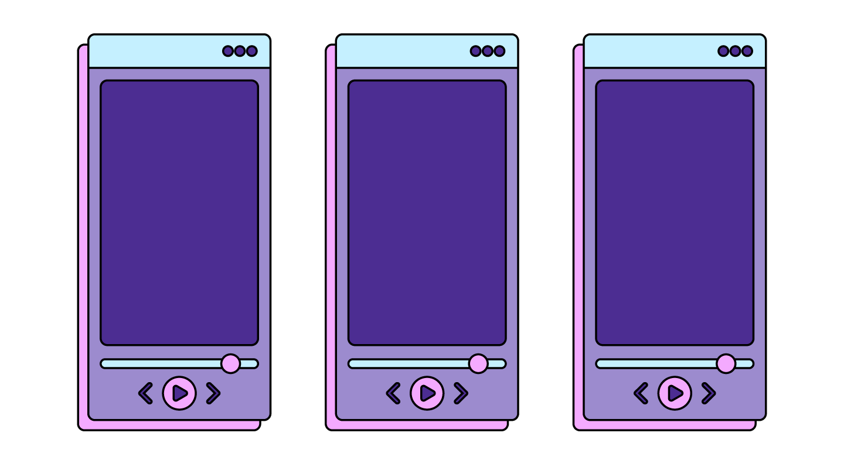
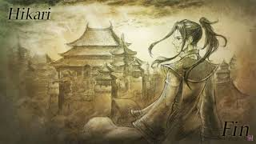
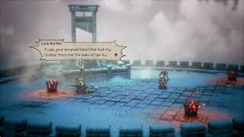
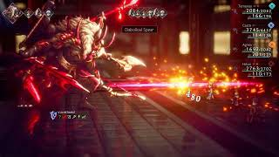
“Hikari, the Warrior”
“In Pursuit of Kingship”
“The Journey for Kingship Ends”
Character theme
Prelude to battle
Final battle theme
Leitmotifs representing people- “Hikari, the Warrior” (Octopath Traveler 2)

Slide 11
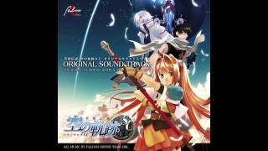
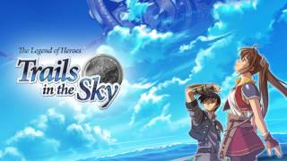
“Hamel”
“Release from the spell, and…”
“Silver Will”
Trails in the Sky SC
Trails in the Sky FC
Trails in the Sky FC
Leitmotifs representing places- “Hamel” (Trails in the Sky Trilogy)

Slide 12
“South Province”
“Koraidon and Moraidon Battle Theme”
“A Long Way to Home”
1st area theme
One phase of final battle
Final cutscene
Leitmotifs representing places- “South Province” (Pokemon Scarlet and Violet)

Slide 13
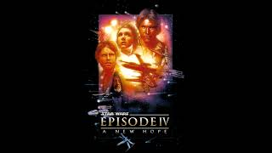
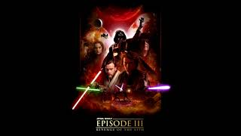
“Binary Sunset”
“Revenge of the Sith”
“Jedi Eulogy”
A New Hope
Revenge of the Sith
Star Wars: The Clone Wars
Leitmotifs representing ideas- “Force Theme” (Star Wars)

Slide 14
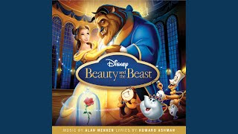
“Prologue: Beauty and the Beast”
“Beauty and the Beast”
“Transformation”
Opening monologue
Main theme
End of the movie
Leitmotifs representing ideas- “Beauty and the Beast” (Beauty and the Beast)

Slide 15
Why do we use leitmotifs?
Set emotions
Signal importance to the audience
Character/Plot development
Evolution
Foreshadowing

Slide 16
EXAMPLES:
Importance, foreshadowing, evolution

Slide 17
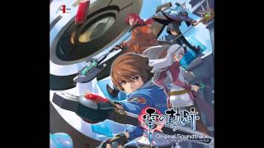
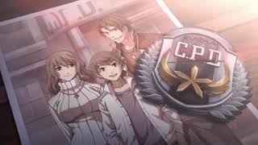
“Zero no Kiseki”
“Gazing at Your Back”
“Courage to Take a Step”
Title Screen theme
Emotional plot moments
Rousing plot moment
Signal Importance- “Zero no Kiseki” (Trails from Zero)

Slide 18
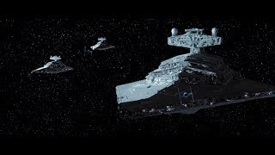
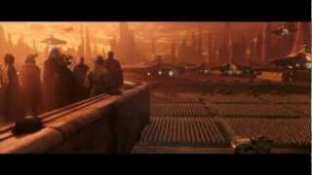
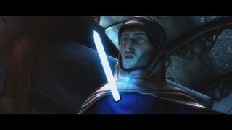
Original Trilogy
Prequel Trilogy
The Clone Wars
Empire Strikes Back
Attack of the Clones
The Clone Wars
Foreshadowing- “Imperial March” (Star Wars)

Slide 19
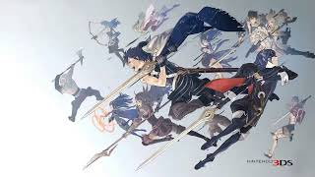
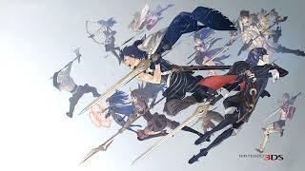
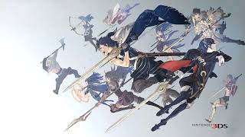
Id (Serenity)
Id (Purpose)
Id (Sorrow)
Early-game scene
Emotional story scene
Final battle theme
Character Evolution- “Id” (Fire Emblem Awakening)

Slide 20
Activity
Group Activity:
Partner/Group up and choose a leitmotif to analyze. What does it represent? What purpose does it serve in the media? How does it change/evolve? etc.

Slide 21
THANK YOU!

